Slide 1

Computer Vision and its Applications
Presenters: Swapnil, Tejal and Vardhan

Slide 2
What is Computer Vision?
Computer vision is a field of artificial intelligence that enables machines to interpret and understand visual information from the world.
Importance:
Automation
Enhances human vision
Data insights

Slide 3
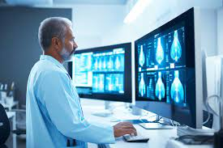
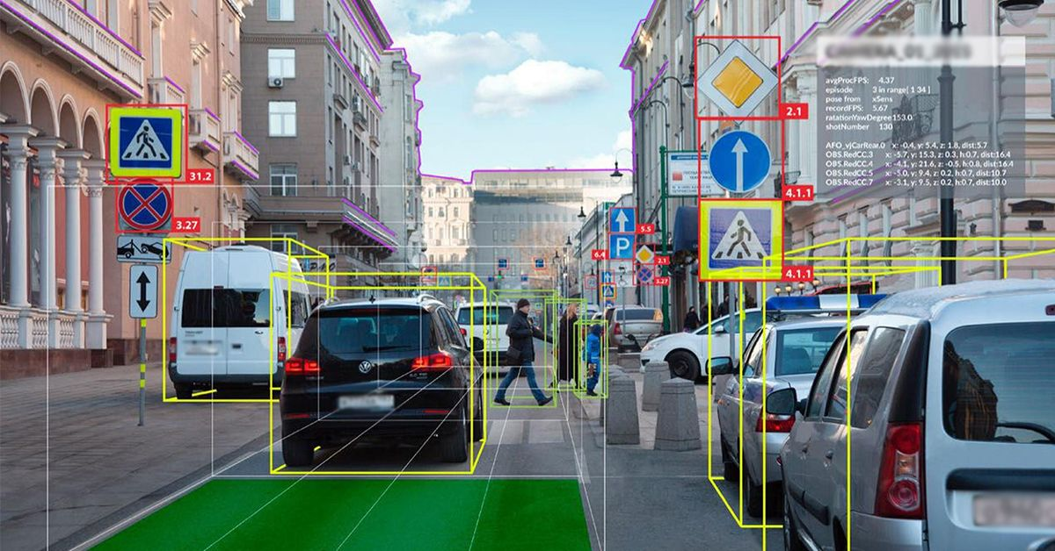
Applications

Slide 4
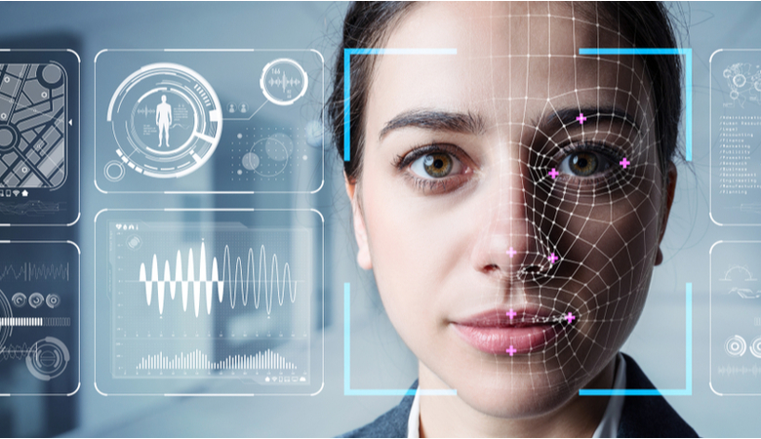
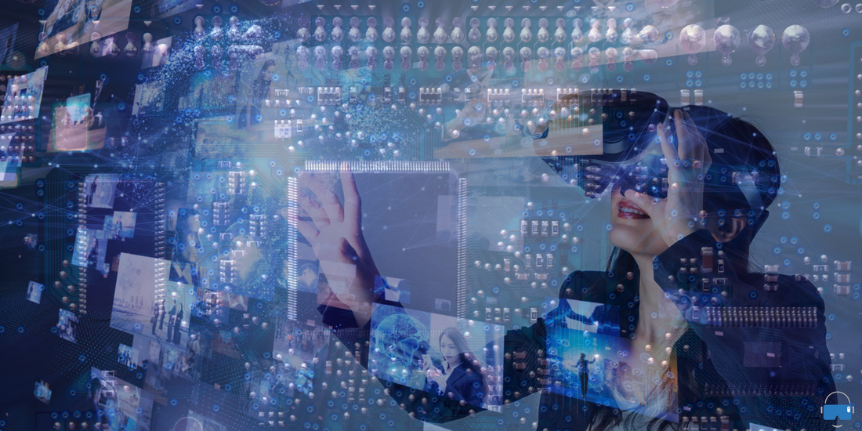
Applications
Security and surveillance

Slide 5
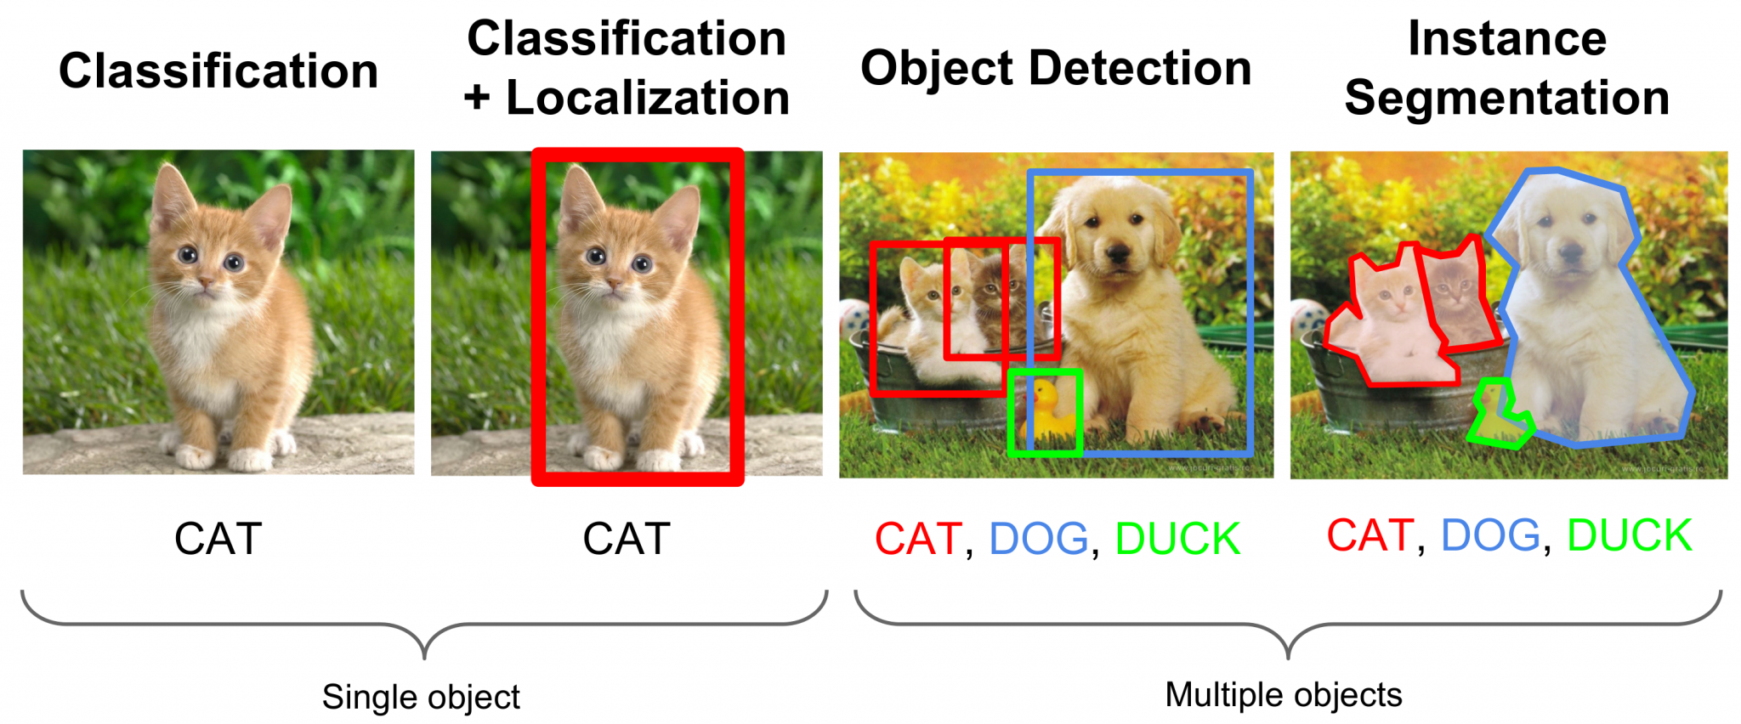
Tasks involved:

Slide 6
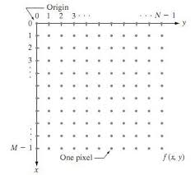
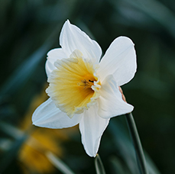

What is an image?

Slide 7
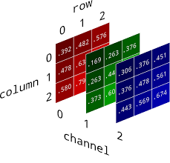
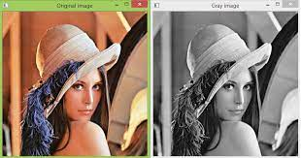
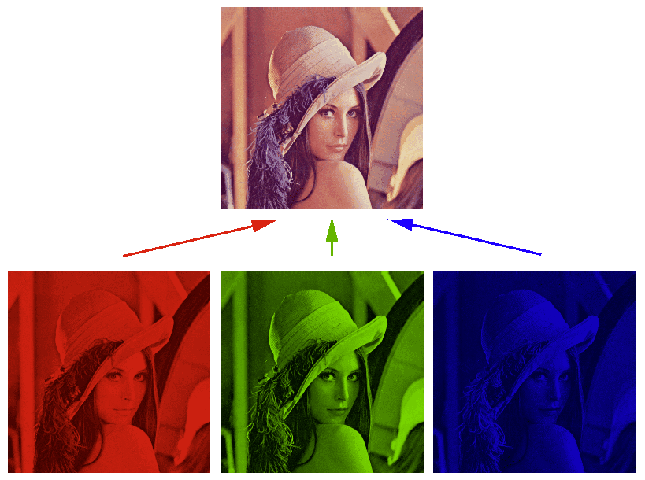
RGB and Grayscale images

Slide 8
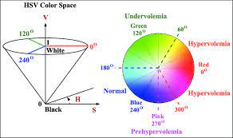
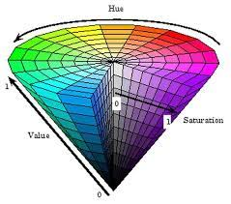
HSV Colour scheme

Slide 9
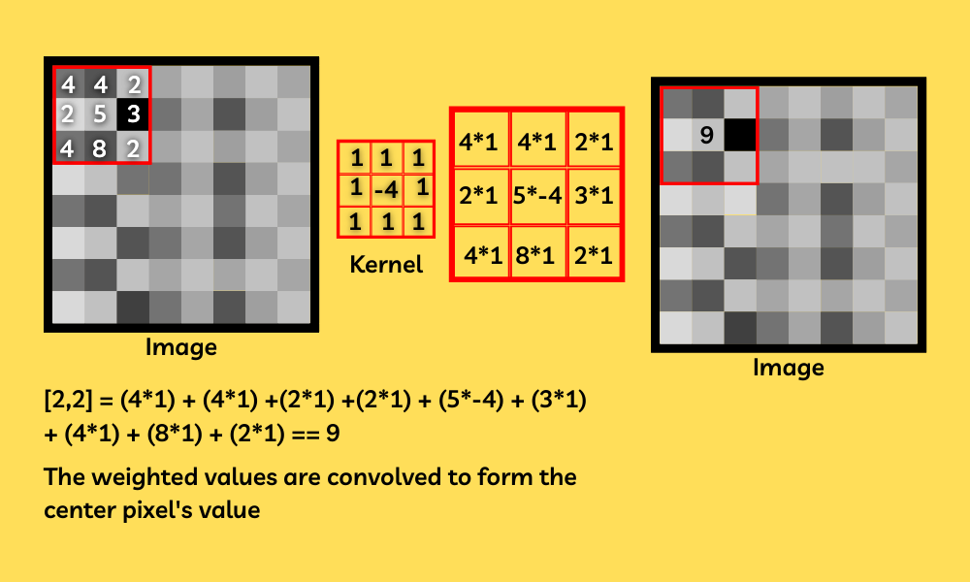
Convolution Operation

Slide 10



Modules

Slide 11
References and Learning Material
1.) Session Github Repo Link: https://github.com/tejalkul/TL-CV-Workshop.git
2.) OpenCV tutorial: https://www.youtube.com/watch?v=oXlwWbU8l2o&pp=ygUPb3BlbmN2IHR1dG9yaWFs
3.) Advanced Learning:
https://www.youtube.com/watch?v=vT1JzLTH4G4&list=PL3FW7Lu3i5JvHM8ljYj-zLfQRF3EO8sYv (Deep Learning Course by Stanford)
https://github.com/priyammaz/HAL-DL-From-Scratch/tree/main (Pytorch For Deep Learning)

Slide 12
Project Ideas
Gesture Recognition:
Build a gesture recognition system to interpret hand gestures captured by the webcam.
Recognise and perform actions based on gestures.
Reference: https://www.youtube.com/watch?v=a99p_fAr6e4&pp=ygUhZ2VzdHVyZSByZWNvZ25pdGlvbiBvcGVuY3YgcHl0aG9u
Motion Detection:
Implement a background subtraction algorithm to detect moving objects in a video stream.
Could be extended to make security system.
References: https://www.youtube.com/watch?v=_zKfYOriFMM&pp=ygUkbW90aW9uIGRldGVjdGlvbiB1c2luZyBvcGVuY3YgcHl0aG9u

Slide 13
Project Ideas
Object Recognition:
Build a gesture recognition system to interpret hand gestures captured by the webcam.
Recognise and perform actions based on gestures.
References: https://www.youtube.com/watch?v=V62M9d8QkYM&pp=ygUmb2JqZWN0IHJlY29nbml0aW9uIHVzaW5nIG9wZW5jdiBweXRob24%3D
Image Segmentation
Implement a background subtraction algorithm to detect moving objects in a video stream.
Could be extended to make security system.
References: https://www.youtube.com/watch?v=UIgaLDgb2fY&pp=ygUmaW1hZ2Ugc2VnbWVudGF0aW9uIHVzaW5nIG9wZW5jdiBweXRob24%3D

Slide 14

Follow us

